Slide 1
IBM Data Science Capstone Car Accident Severity – Machine Learning Prediction Models

Slide 2
Introduction and Business Problem
1.35 million people die in road accidents worldwide every year that is 3,700 deaths a day. An additional 20-50 million suffer non-fatal injuries, often resulting in long-term disabilities. Also, fatal car wrecks and road accidents cost countries worldwide about 3% of their GDP.
Several factors influence the occurrence and severity of car accidents including behavioral, environmental and situational factors.
Due to the availability of large amount of accident related data it is possible to build machine learning models to predict the severity of car accidents.
Many institutions including local governments, police departments, healthcare institutions, rescue groups, insurance companies may benefit from such predictive models.

Slide 3
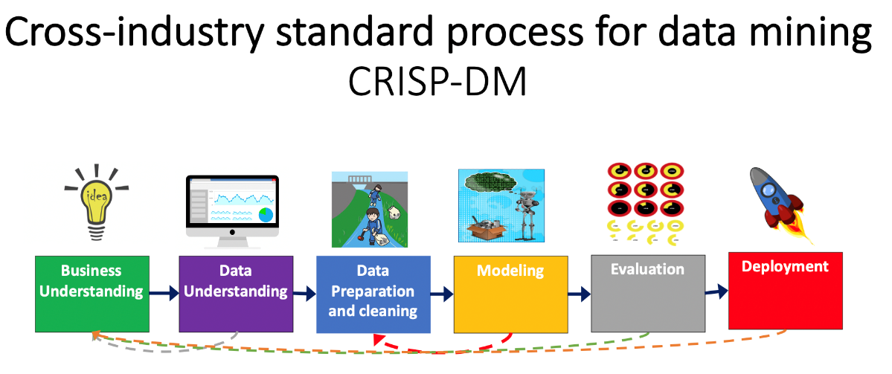
Approach to Tackle the Problem
Supervised machine learning models were built and evaluated. K-Nearest Neighbours, Decision Tree, Support Vector Machines and Logistic Regression were implemented.
Cross-Industry standard process for Data Mining (CRISP-DM) was followed throughout the process.

Slide 4
Data Collection and Understanding
Collision data collected by the Seattle Police Department (SPD) and recorded by the Traffic Records team was used. The data covers 214,050 collision records spanning from October 2003 to September 2020.
The data has 40 attributes including the dependent variable “SEVERITYCODE” which represents the severity of the collision represented by the following codes and their respective severity:
3 for fatality
2b for serious injury
2 for injury
1 for prop damage
0 for unknown

Slide 5
Data Collection and Understanding (cont’d)
Following data understanding, a subset of the attributes related to the occurrence and severity of the collisions were selected.
The following attributes of interest were considered to train the model. As part of the “Data Preparation”, balancing unbalance data and cleaning the dataset will be performed if required.
Attribute | Description
ADDRTYPE | Collision address type: Alley, Block, or Intersection
PERSONCOUNT | The total number of people involved in the collision
PEDCOUNT | The number of pedestrians involved in the collision
PEDCYLCOUNT | The number of bicycles involved in the collision
VEHCOUNT | The number of vehicles involved in the collision
INJURIES | The number of total injuries in the collision
FATALITIES | The number of fatalities in the collision
INCDTTM | The date and time of the incident
JUNCTIONTYPE | Category of junction at which collision took place
INATTENTIONIND | Whether or not collision was due to inattention (Y/N)
UNDERINFL | Whether or not a driver involved was under the influence of drugs or alcohol
WEATHER | A description of the weather conditions during the time of the collision
ROADCOND | The condition of the road during the collision
LIGHTCOND | The light conditions during the collision
SPEEDING | Whether or not speeding was a factor in the collision (Y/N)
HITPARKEDCAR | Whether or not the collision involved hitting a parked car (Y/N)

Slide 6
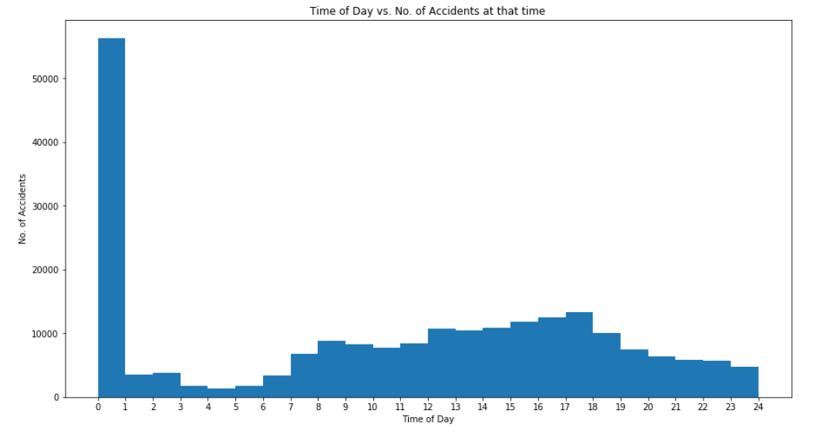
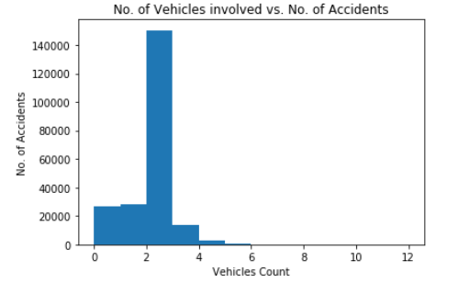
Data Visualization
Comprehensive data visualization was conducted on the dataset. Following are some of the observations:
Very high percentage of the accidents occur around midnight.
Majority of accidents involve 2-4 vehicles

Slide 7
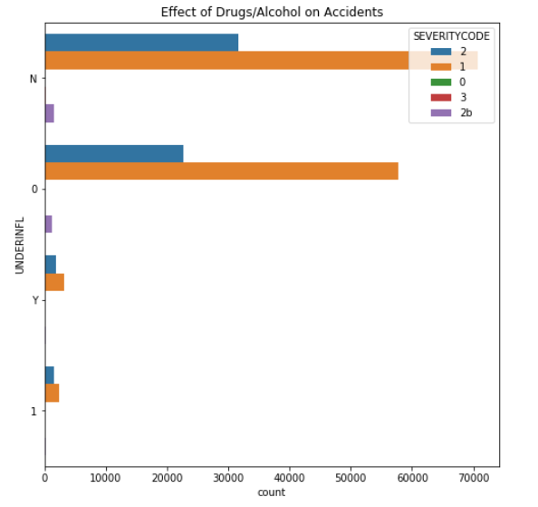
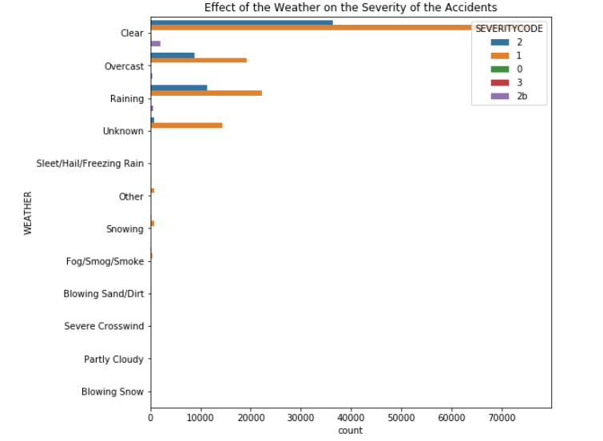
Data Visualization (Cont’d)
Comprehensive data visualization was conducted on the dataset. Following are some of the observations:
Number and severity of collisions whilst driving under the influence of alcohol and drugs are low.
Number and severity of collisions were not hugely impacted by weather conditions.

Slide 8
Data Preparation and Cleaning
As the dataset was imbalanced, balancing of the dataset was conducted.
Binary Encoding and One Hot Encoding of the relevant data was implemented.
Missing Data of certain attributes were filled and the rest of the records with missing data were dropped.
Feature selection of the data was conducted.
Dataset was normalized.

Slide 9
Modeling
Train/Test Data was split to 0.8/0.2 ratio.
Accuracy scores were calculated for the following models that were trained.
K-Nearest Neighbors (KNN): Accuracy score of 0.57
Decision Tree: Accuracy of 0.6
Support Vector Machine: Accuracy of 0.6
Logistic Regression: Accuracy of 0.6

Slide 10
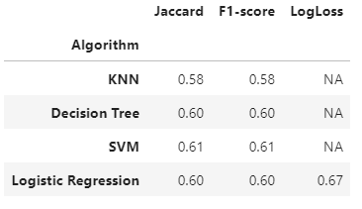
Evaluation and Conclusion
The trained models were evaluated and reported by using the Jaccard Score, F1 Score and the Log Loss.
Following table summarizes the results. Based on these results, all the four models have similar performance.
The accuracy of the models has room for improvement.

